Slide 1
Introduction to Software Security
Dr Sana Belguith

Slide 2
Memory Corruption bugs
Software has bugs: Sometimes we can use these bugs to violate security principles
Memory corruption bugs (and memory safety)
An example of programming errors
Property of specific type of languages, called memory unsafe languages.
One of the most used bugs for exploitation: Corrupt the memory of a program to violate security principles
Can lead to:
arbitrary read
arbitrary write
control flow hijack
control flow corruption

Slide 3
Pointers
Pointers allow you to refer to (semi) arbitrary memory addresses in most programming languages
in C
Some languages claim not to have them (e.g. Java)
Not strictly true… just not usually as easy to abuse as Cs
Objects
To introduce a bug…
Get a pointer pointing somewhere it shouldn’t

Slide 4
Memory Safety
When object boundary access is violated via pointers.
Spatial Safety^{[1]}:
– A spatial safety violation is an error in which a pointer is used to access the data at a location in memory that is outside the bounds of an allocated object.
The error is ‘spatial’ in the sense that the dereferenced pointer refers to an incorrect location in memory.
–
[1]: MemSafe: ensuring the spatial and temporal memory safety of C at runtime

Slide 5
Memory Safety
Temporal Safety[1]
A temporal safety violation is an error in which a pointer is used in an attempt to access or deallocate an object that has already been deallocated.
The violation is ‘temporal’ in the sense that the pointer use occurs at an invalid instance during the execution of the program (i.e., after the object to which it refers has been deallocated).
[1]: MemSafe: ensuring the spatial and temporal memory safety of C at runtime

Slide 6
Memory Corruption bugs
What happens if you go beyond a local array’s end?
You can get arbitrary execution…
Sometimes called a spatial error
For further reading: See Smashing the stack for fun and profit
What happens if you use memory after you’ve freed it?
You can get an arbitrary write…
Sometimes called a temporal error
For further reading: See the malloc maleficarum

Slide 7
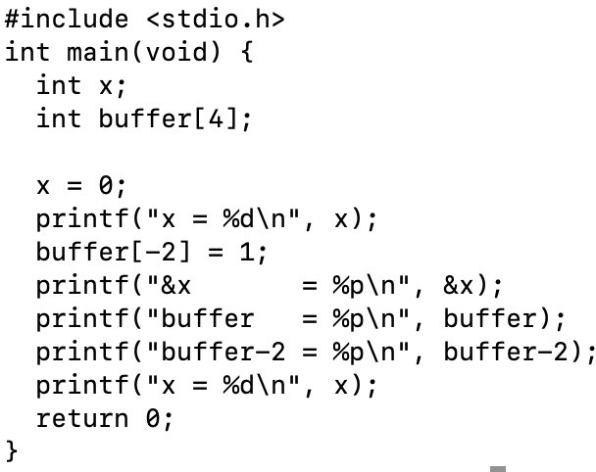
Example

Slide 8
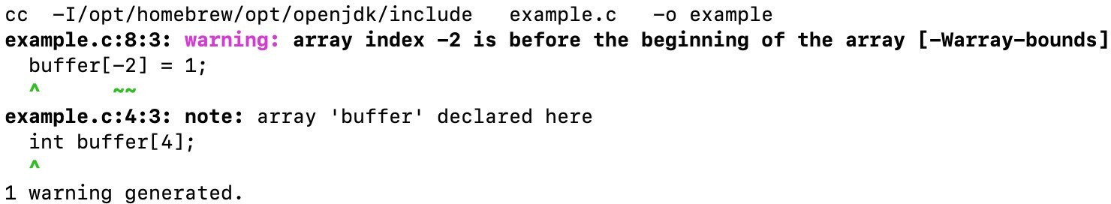
Example
What happens when we compile it ? Obviously, a warning…
This is technically allowed by the C standard so not an error

Slide 9
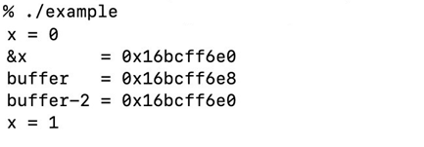
What happens if we run it ? We have over-written X without explicitly pointing to it
Example

Slide 10
The problem with C (and C++)
C was designed to write operating systems
Programmers were expected to know what they were doing
i.e. if you are going off the end of an array its deliberate and not a mistake
If you do not know what you are doing C can be dangerous…
There is no type safety like Java or Haskell
You can do strange maths with pointers
Programmers have been trained to ignore warnings…

Slide 11
How do we fix this?
Short term:
Do not teach programmers unsafe practice
Listen to your compiler
Longer term
Maybe we should make it harder to do dangerous things?
Language standard, compilers, and tools evolve.

Slide 12
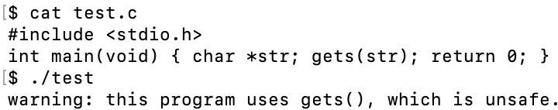
Buffer Overflow
You get told that functions like gets or strcpy in C are dangerous and should not be used…
…some OSs will even start outputting warnings to users!?
…why?
=> Buffer overflow vulnerability

Slide 13
Buffer Overflow
Several decades old problem (still appears in SANS TOP 25 Software errors!!)
Main cause: putting more data than intended!!
Consequences: memory corruption (can be very dangerous!)

Slide 14
Buffer Overflow
What happens when you declare array?
You get a region of memory
Pointers are used to address arrays
Very easy to fall off the end of the region!
Have been known about since the dawn of computers, but earliest tutorial on how to exploit them in Phrack magazine
Smashing the Stack for Fun and Profit by Aleph1
http://phrack.org/issues/49/14.html

Slide 15
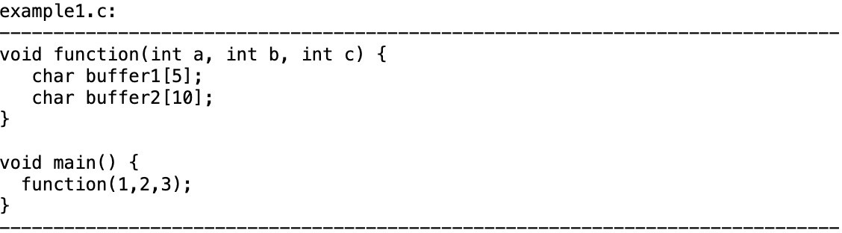
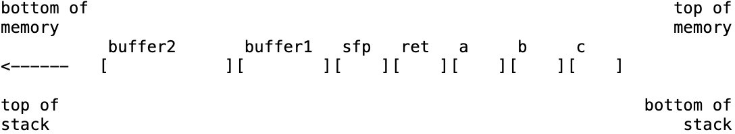
Example

Slide 16
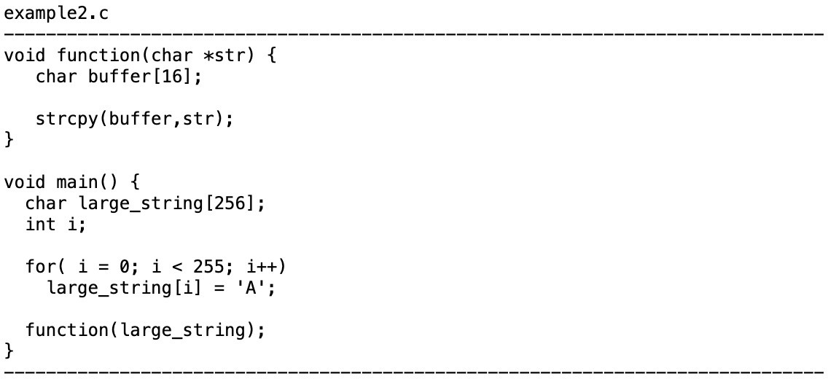

Slide 17
bottom of memory
top of memory
buffer sfp
[AAAAAAAAAAAAAAAA][
ret *str
]
<------
][
][
top of stack
bottom of
stack

Slide 18
bottom of memory
top of memory
buffer sfp ret *str [AAAAAAAAAAAAAAAA][AAAA][ ][ ]
<------
top of stack
bottom of
stack

Slide 19
bottom of memory
top of memory
buffer sfp ret *str
]
<------
[AAAAAAAAAAAAAAAA][AAAA][AAAA][
top of stack
bottom of
stack

Slide 20
bottom of memory
top of memory
buffer sfp ret *str [AAAAAAAAAAAAAAAA][AAAA][AAAA][AAAA]AAAAAAAAAAAAAAAAAAAAAAAAAAAAAAAA
<------
top of stack
bottom of
stack

Slide 21
BoF Consequences
At this point the program probably crashes
Unless 0xAAAA contains valid program code… the CPU can’t run from there so you’ll probably get an illegal instruction exception

Slide 22
What happens ?
Lets say this overflow happens…
…maybe you corrupt some local stack data
…maybe you overflow onto some protected memory region and trigger a segfault?
Suppose you don’t trigger a segfault…
…what happens when the function returns?

Slide 23
bottom of memory
top of memory
buffer sfp ret *str
]
<------
[AAAAAAAAAAAAAAAA][AAAA][AAAA][
| V
rip
top of stack
bottom of
stack

Slide 24
BoF Consequences
But we kind of know where some stuff is in memory…
…the stack (in particular) is fairly predictable
…and we control what we put into that buffer…
…so we could put valid instruction sequences into it
…in which case we could make the program start to run our own code instead of its own…

Slide 25
BoF Countermeasures
Modern CPUs don’t allow you to write to regions of memory you can execute, or execute from regions of memory you can write to
But you can get round this…
Return to libc or ROP (We’ll cover them in Software and Systems Security in year 4)
Stack canaries help prevent exploitation
Stick a random number before the return address… check it hasn’t changed before returning
Shadow stacks also help
Keep a second stack with just the return addresses on… check its consistent with the main stack
Not implemented everywhere

Slide 26
BoF Countermeasures
If you’re using C use the bounded strcpy/gets variants, use safe version of C APIs
strnpcy is better than strcpy
fgets is better than gets
A quick read:
https://security.web.cern.ch/recommendations/en/codetools/c.shtml

Slide 27
Format String Errors
Formatted output functions consist of a format string and a variable number of arguments.
The format string provides a set of instructions that are interpreted by the formatted output function.
By controlling the content of the format string a user can control execution of the formatted output function.

Slide 28
Format strings
Format String
Format strings are character sequences consisting of ordinary characters and
conversion specifications.
Conversion specifications convert arguments according to a corresponding conversion specifier, and write the results to the output stream.
Conversion specifications begin with a percent sign (%) and are interpreted from left to right.
If there are more arguments than conversion specifications, the extra arguments are ignored.
If there are not enough arguments for all the conversion specifications, the results are undefined.

Slide 29
Example functions
Format String
vfprintf()
fprintf()
vprintf()
printf()
vsprintf()
sprintf()
vsnprintf()
snprintf()

Slide 30
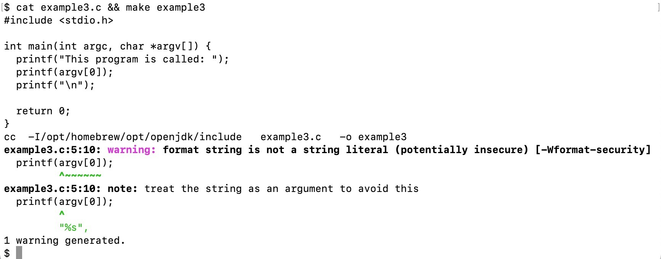
Format String

Slide 31
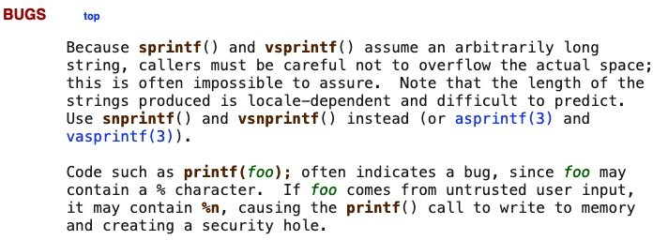
man 3 printf
Format String

Slide 32
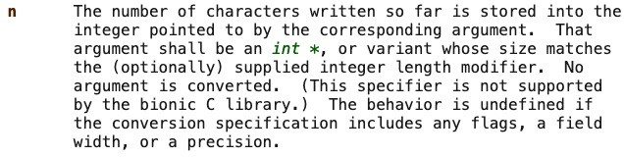
Format String
%n?
LibC’s printf function handles formatted output…
%s prints a string…
%d or %i prints a decimal integer…

Slide 33
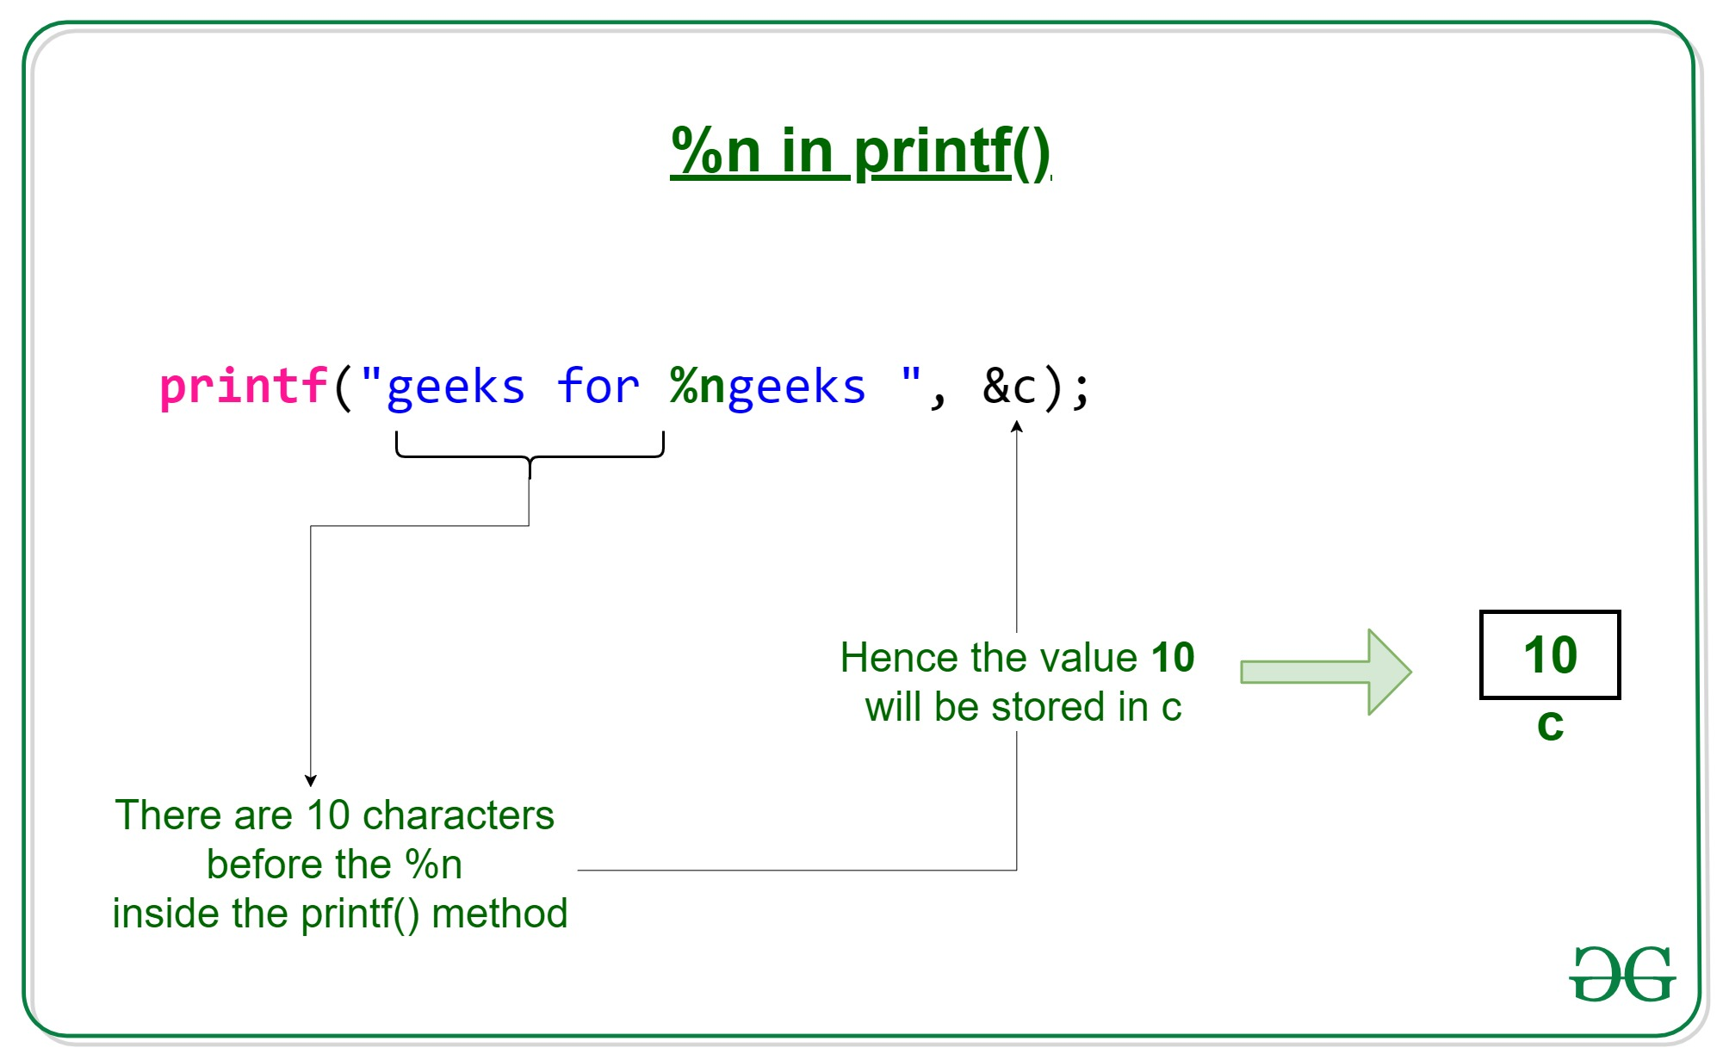
Format String
https://www.geeksforgeeks.org/g-fact-31/

Slide 34
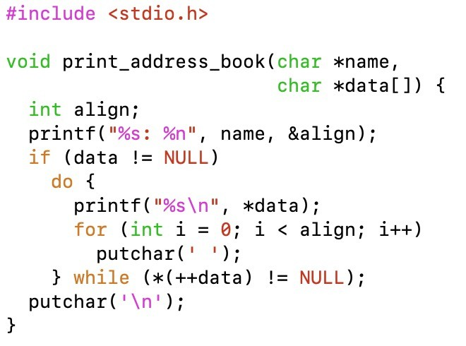
Say you wanted to do columnar output (and were really weird)
Format String, How ?
Say we have an address book we want to print like the following
Sana Belguith: 3.16 MVB, Bristol
01234 567890
Born 1988-03-15
Notes:
N will find how many characters I am printing
Even if I print shorter name or longer name
Strlen would this safely ut this is how it was designed
It will still load that number of spaces

Slide 35
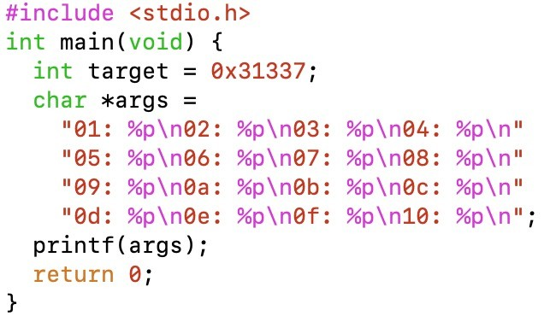
Format String, How ?
Say you control the format string…
Format string arguments typically passed via the stack
What happens if you print more arguments than you have?

Slide 36
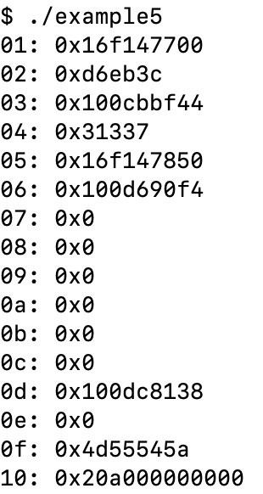
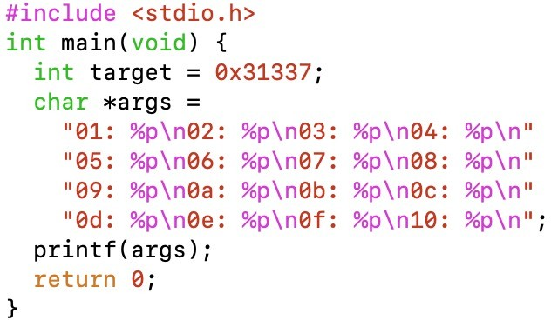
Format String, How ?
Notes:
If we control how many characters we printed on the stack we can intentionnaly change that target argument
Because we know where it is exactlky

Slide 37
Format String Consequences
By careful choice of format string we can write to arbitrary addresses somewhere after the stack pointer…
This could be a local variable…
Data corruption
This could be return address…
Control flow corruption and arbitrary code execution

Slide 38
Going further…
See Exploiting format string vulnerabilities by scut/team teso
See Exploiting a format string bug in Solaris CDE (Phrack Magazine, Volume 0x16, Issue 0x46) by Marco Ivaldi
(or take Systems and Software Security in Year 4 ;-) )

Slide 39
Why is this even still a thing?
We don’t need dangerous cruft from the 1970s in our programming languages just to save a call to strlen() anymore.
– We didn’t really back then either…

